Slide 1

RoseVision: An Android Application To Detect Rose Leaf Diseases Using Modified Convolutional Neural Network
Saidul Islam Nayan, Syed Mahfuzur Rahman, Nosin Ibna Mahbub
Dept. of Computer Science and Engineering, University of Global Village, Barishal-8200, Bangladesh Dept. of Information and Communication Technology, Islamic University, Kushtia-7003, Bangladesh

Slide 2



Content
01
Overview
02
Related Works
03
Introduction
04
Objectives
05
Materials & Methods
06
Results
07
Conclusion
08
References

Slide 3
1
Overview
Every year 28% of the global cut rose production is hampered by various rose plant diseases.
Early detection and classification could diminish the cost of cultivation lost.
However, without proper knowledge and expert assistance, farmers are facing challenges to identify the diseases in time to take action.

Slide 4
2
Related Works
Paper Name | Used Model | Test Accuracy | Dataset Size | Testing Time | Mobile App
Detection of Black Spot of Rose Based on Hyperspectral Imaging and Convolutional Neural Network | NDDR-CNN | 96.5% | 1800 | N/A | NO
Rose Leaf Disease Detection Using CNN | Custom CNN | 96% | N/A | N/A | NO
Automated Detection of Plant Diseases Using Image Processing and Faster R-CNN Algorithm | Faster RCNN | 67.34% | 236 | N/A | Proposed
Rose Diseases Recognition using MobileNet | MobileNet | 95.63% | 1600 | N/A | NO
Mobile Platform Implementation of Lightweight Neural Network Model for Plant Disease Detection and Recognition | Custom CNN | 89% | 6,970 | N/A | NO
Design and Implementation of an Efficient Rose Leaf Disease Detection using K-Nearest Neighbours | KNN | 97.3% | N/A | N/A | NO
A Hybrid Deep Learning and Optimized Machine Learning Approach for Rose Leaf Disease Classification | Hybrid VGG16 | 90.26% | N/A | N/A | NO
RoseVision: An Android Application To Detect Rose Leaf Diseases Using Modified Convolutional Neural Network | Proposed MCNN | 97.94% | 4342 | 0.074s | YES

Slide 5
3
Introduction
So far, no study has been done to develop an efficient automatic mobile application detection system with faster, lighter, and more accurate predictions.
Most of the modern CNN models use larger and deeper convolutional neural networks (CNN) that take more time to train and test. networks
Here, we designed a modified convolutional neural network (MCNN) which is lightweight and takes less time to train and test correctly.

Slide 6
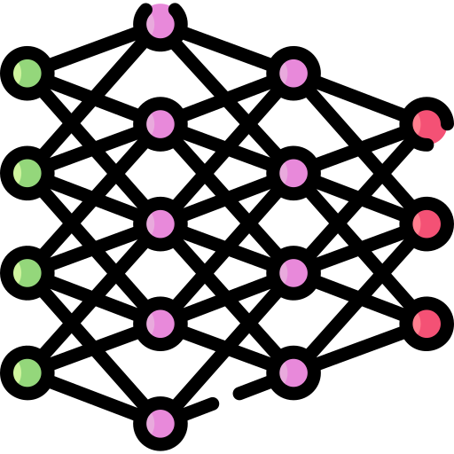



4
Comparative Study
CNN Architecture
Performance Evaluation
Mobile App Development

Slide 7
Key Prospects
5
01
Propose A Modified Convolutional Neural Network
Evaluating The Model
Accuracy And Comparison
02
03
Calculating The Average Testing Time and Performance Evaluuation
Empowering A Mobile Application With The MCNN Model
04

Slide 8





Objectives
6
Improving Performance
Detect Rose Leaf Diseases
Develop Automation App
Reduce Cultivation Loss

Slide 9
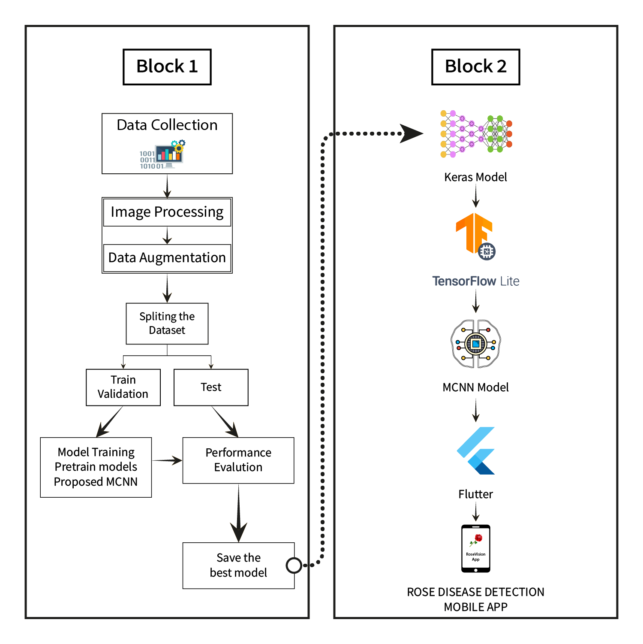
Materials & Methods
7
The entire procedure of this study

Slide 10
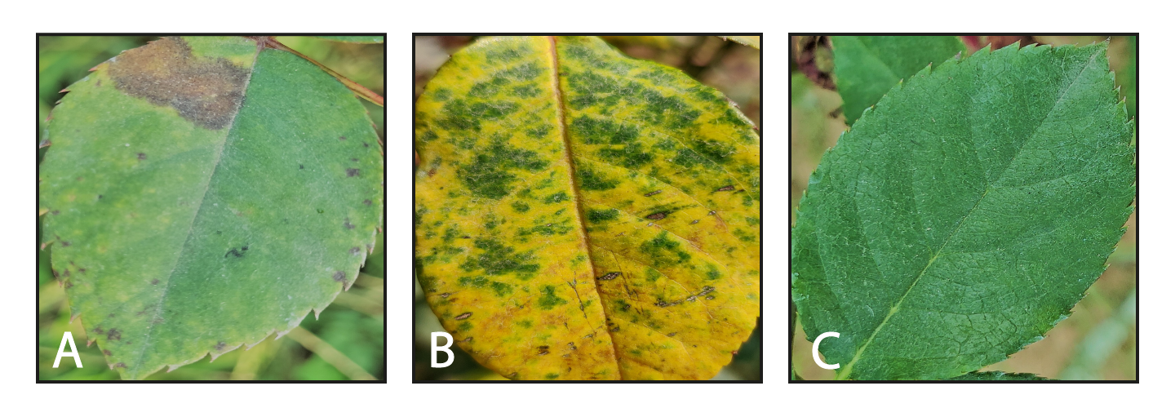
Dataset Collection
8
RoseNet dataset (an extensive dataset of 4342 images of rose leaves, both diseased and disease-free, classified into three classes.)
Category Name | No. of Images
Black Spot | 1434
Downy Mildew | 1478
Fresh Leaf | 1430

Slide 11
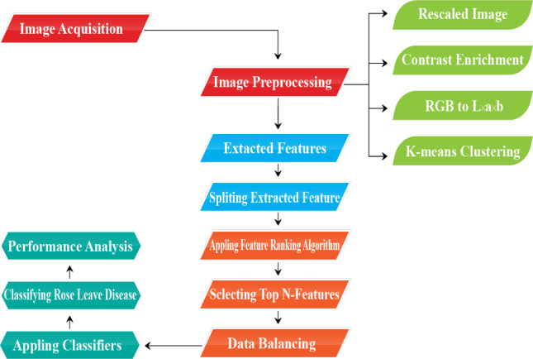
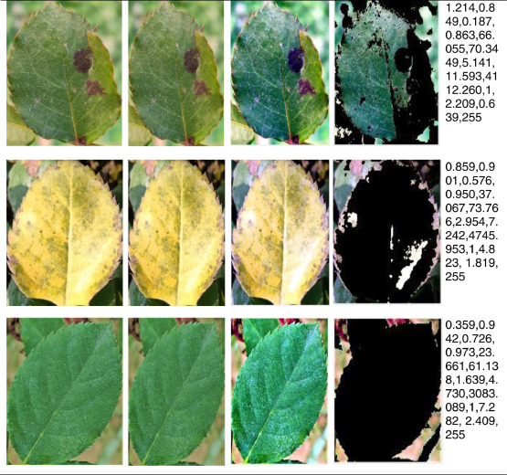
Data Preprocessing
9

Slide 12
10
Image Acquisition
Reducing their Resolution
Image Standardization
Data Augmentation
Train Test Validation Split

Slide 13
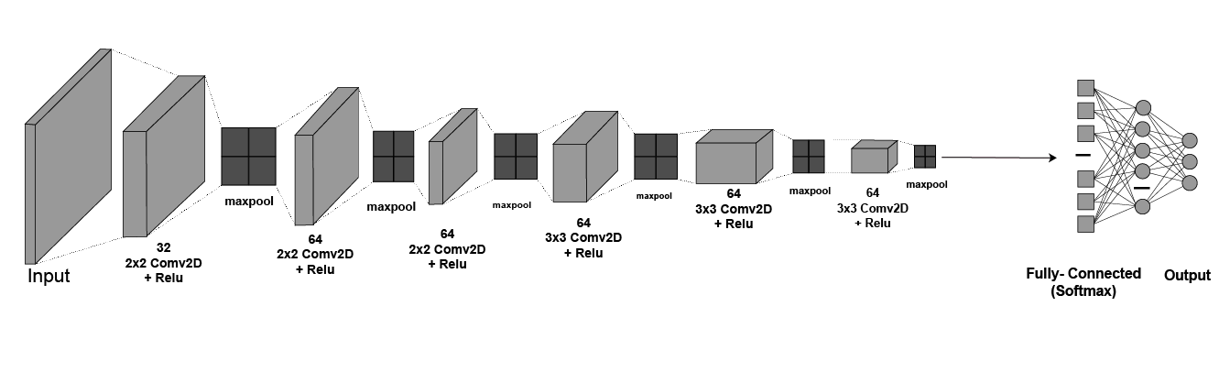
Model Architecture
11

Slide 14
Model Parameters
12
Parameter Name | Values
Number of epochs | 35
Batch size | 32
Loss function | Categorical cross entropy
Learning rate | 0.001
Activation function | Relu and Softmax
Optimizer | Adam
Train: Validation: Test | 70:20:10

Slide 15
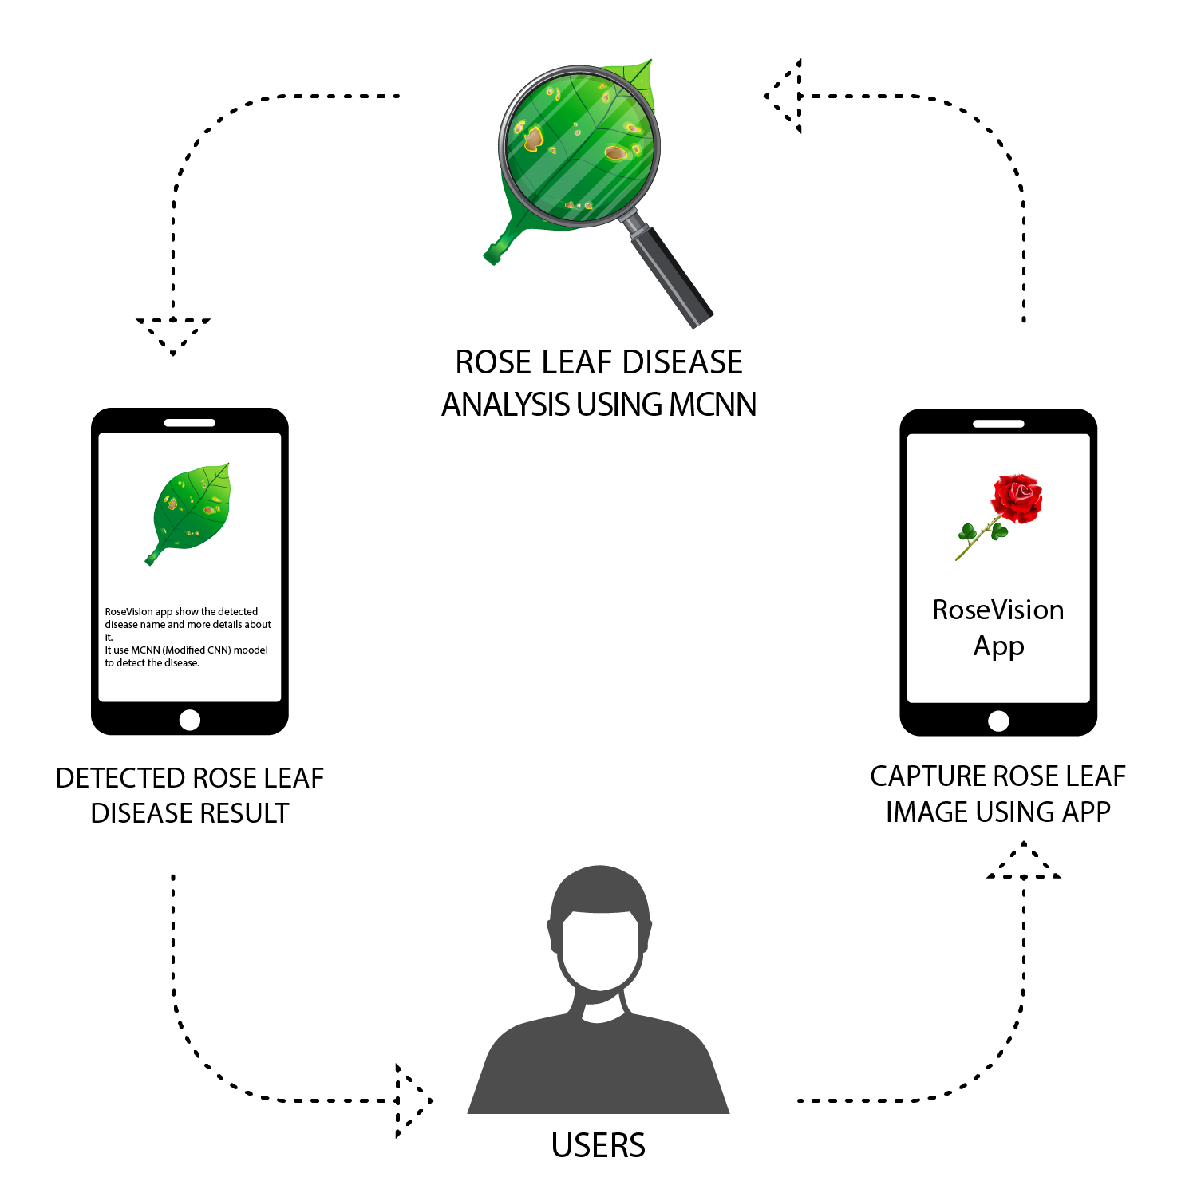
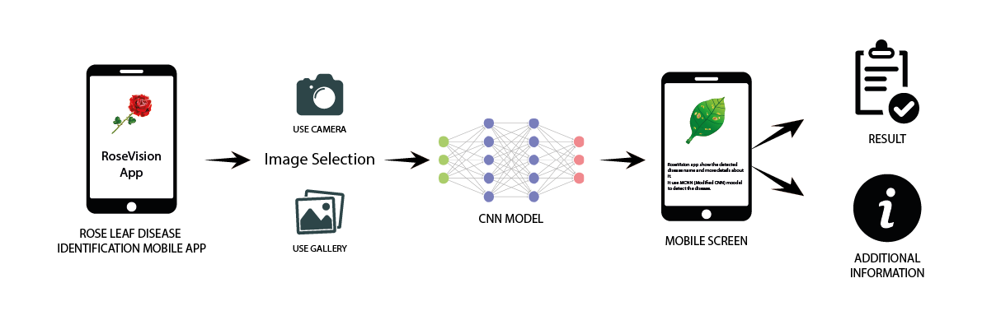
App Development
13

Slide 16
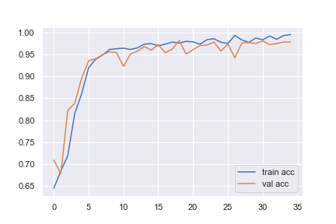
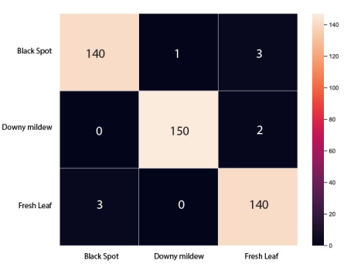
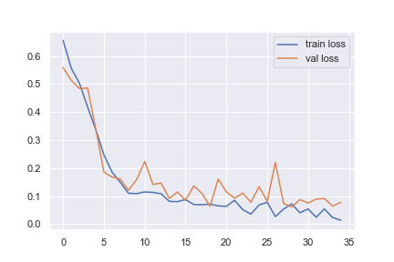
Results
14

Slide 17
Model Name | Class Name | Precision | Recall | F1-score
DenseNet12 | Black Spot | 0.95 | 0.99 | 0.97
 | Downy Mildew | 0.99 | 0.99 | 0.99
 | Fresh Leaf | 0.99 | 0.96 | 0.98
MobileNetV | Black Spot | 0.97 | 0.98 | 0.97
 | Downy Mildew | 0.99 | 0.99 | 0.99
 | Fresh Leaf | 0.97 | 0.96 | 0.97
InceptionV3 | Black Spot | 0.93 | 0.90 | 0.92
 | Downy Mildew | 0.98 | 0.99 | 0.99
 | Fresh Leaf | 0.92 | 0.94 | 0.93
ResNet50 | Black Spot | 0.68 | 0.61 | 0.64
 | Downy Mildew | 0.92 | 0.94 | 0.93
 | Fresh Leaf | 0.70 | 0.76 | 0.73
VGG16 | Black Spot | 0.94 | 0.97 | 0.95
 | Downy Mildew | 0.99 | 0.98 | 0.98
 | Fresh Leaf | 0.96 | 0.94 | 0.95
VGG19 | Black Spot | 0.99 | 0.86 | 0.92
 | Downy Mildew | 0.98 | 0.98 | 0.98
 | Fresh Leaf | 0.88 | 1.0 | 0.94
Xception | Black Spot | 0.93 | 0.98 | 0.96
 | Downy Mildew | 0.99 | 0.99 | 0.99
 | Fresh Leaf | 0.98 | 0.92 | 0.95
Proposed MCNN | Black Spot | 0.98 | 0.97 | 0.98
 | Downy Mildew | 0.99 | 0.99 | 0.99
 | Fresh Leaf | 0.97 | 0.98 | 0.97
15

Slide 18
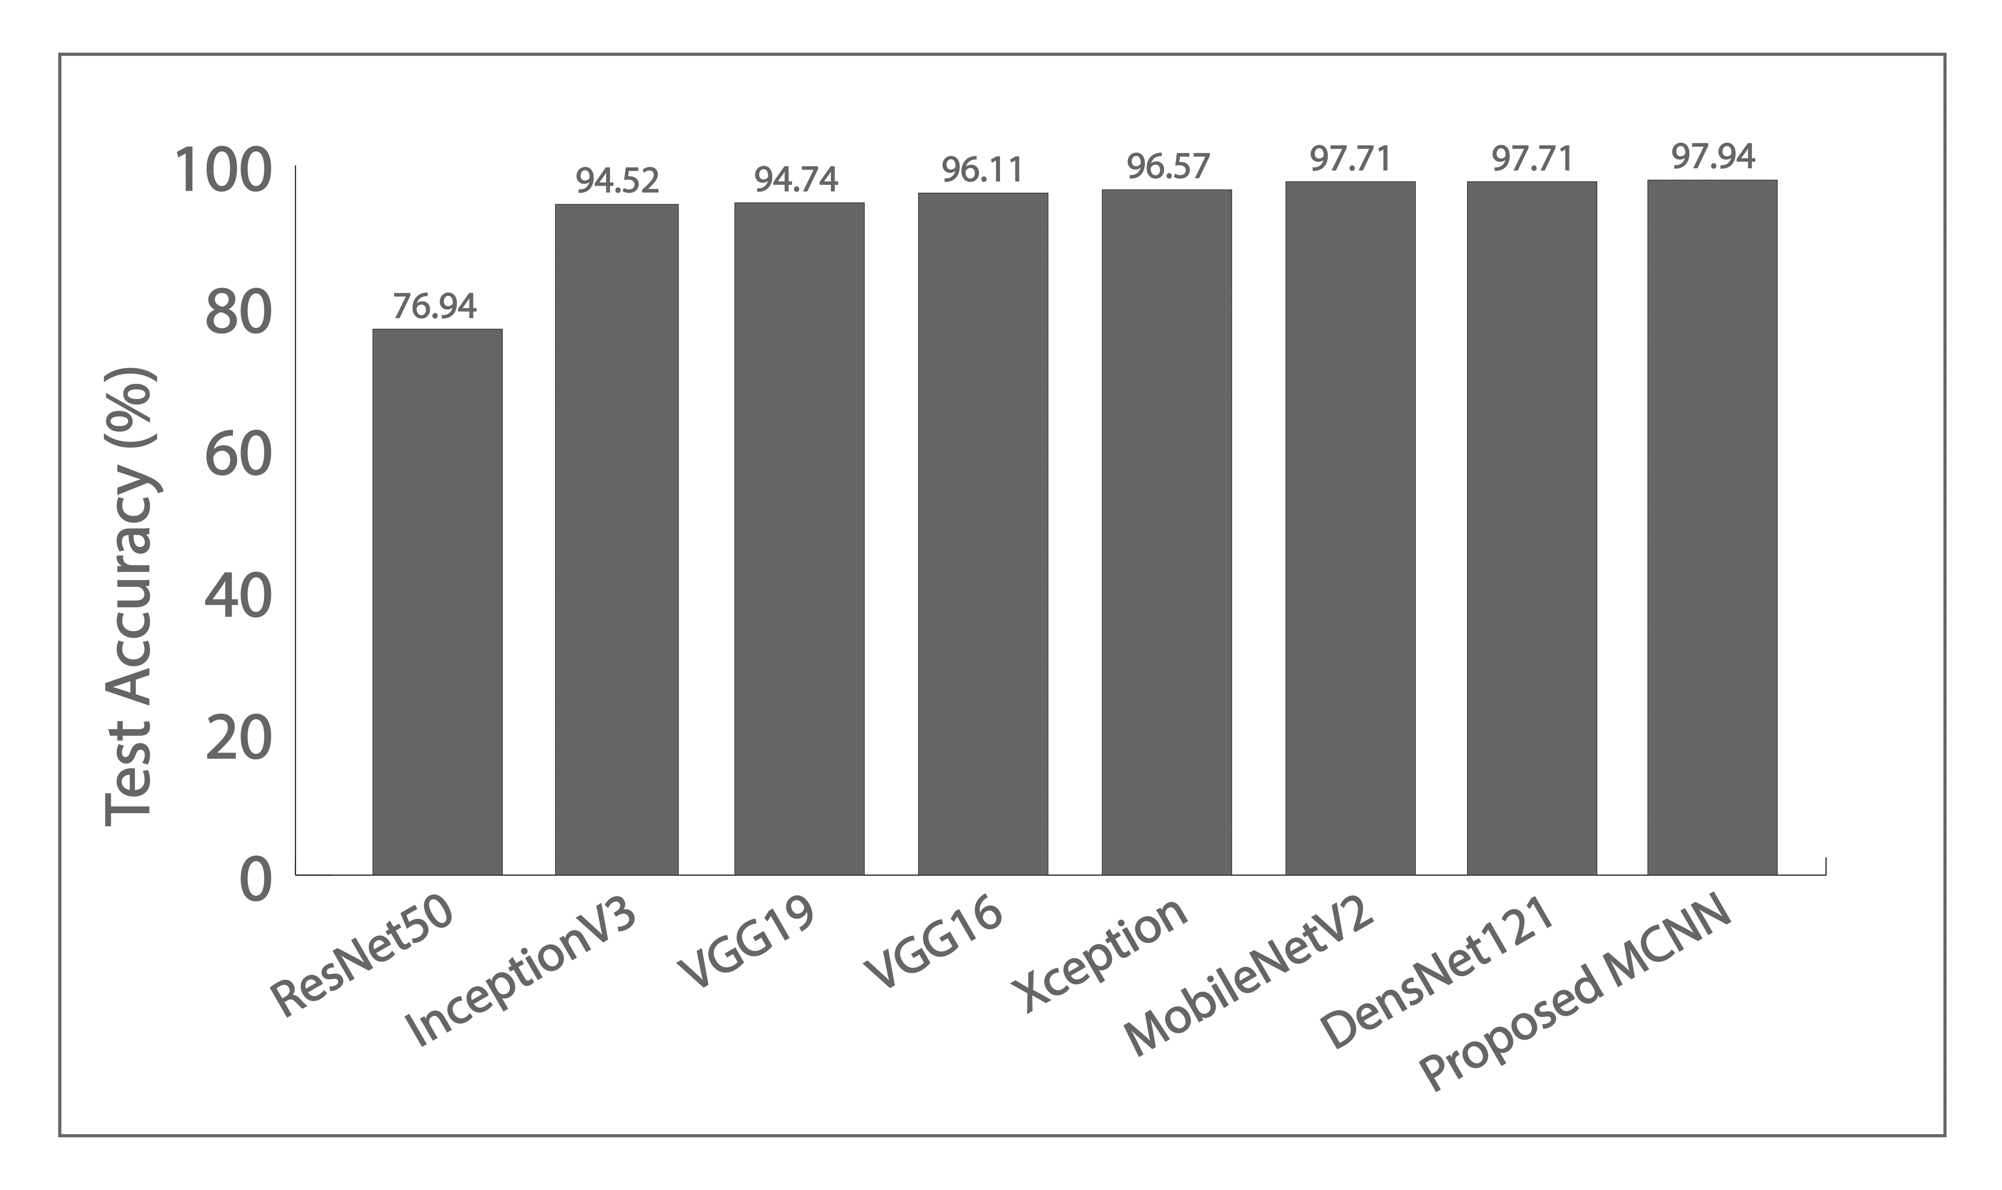
16

Slide 19
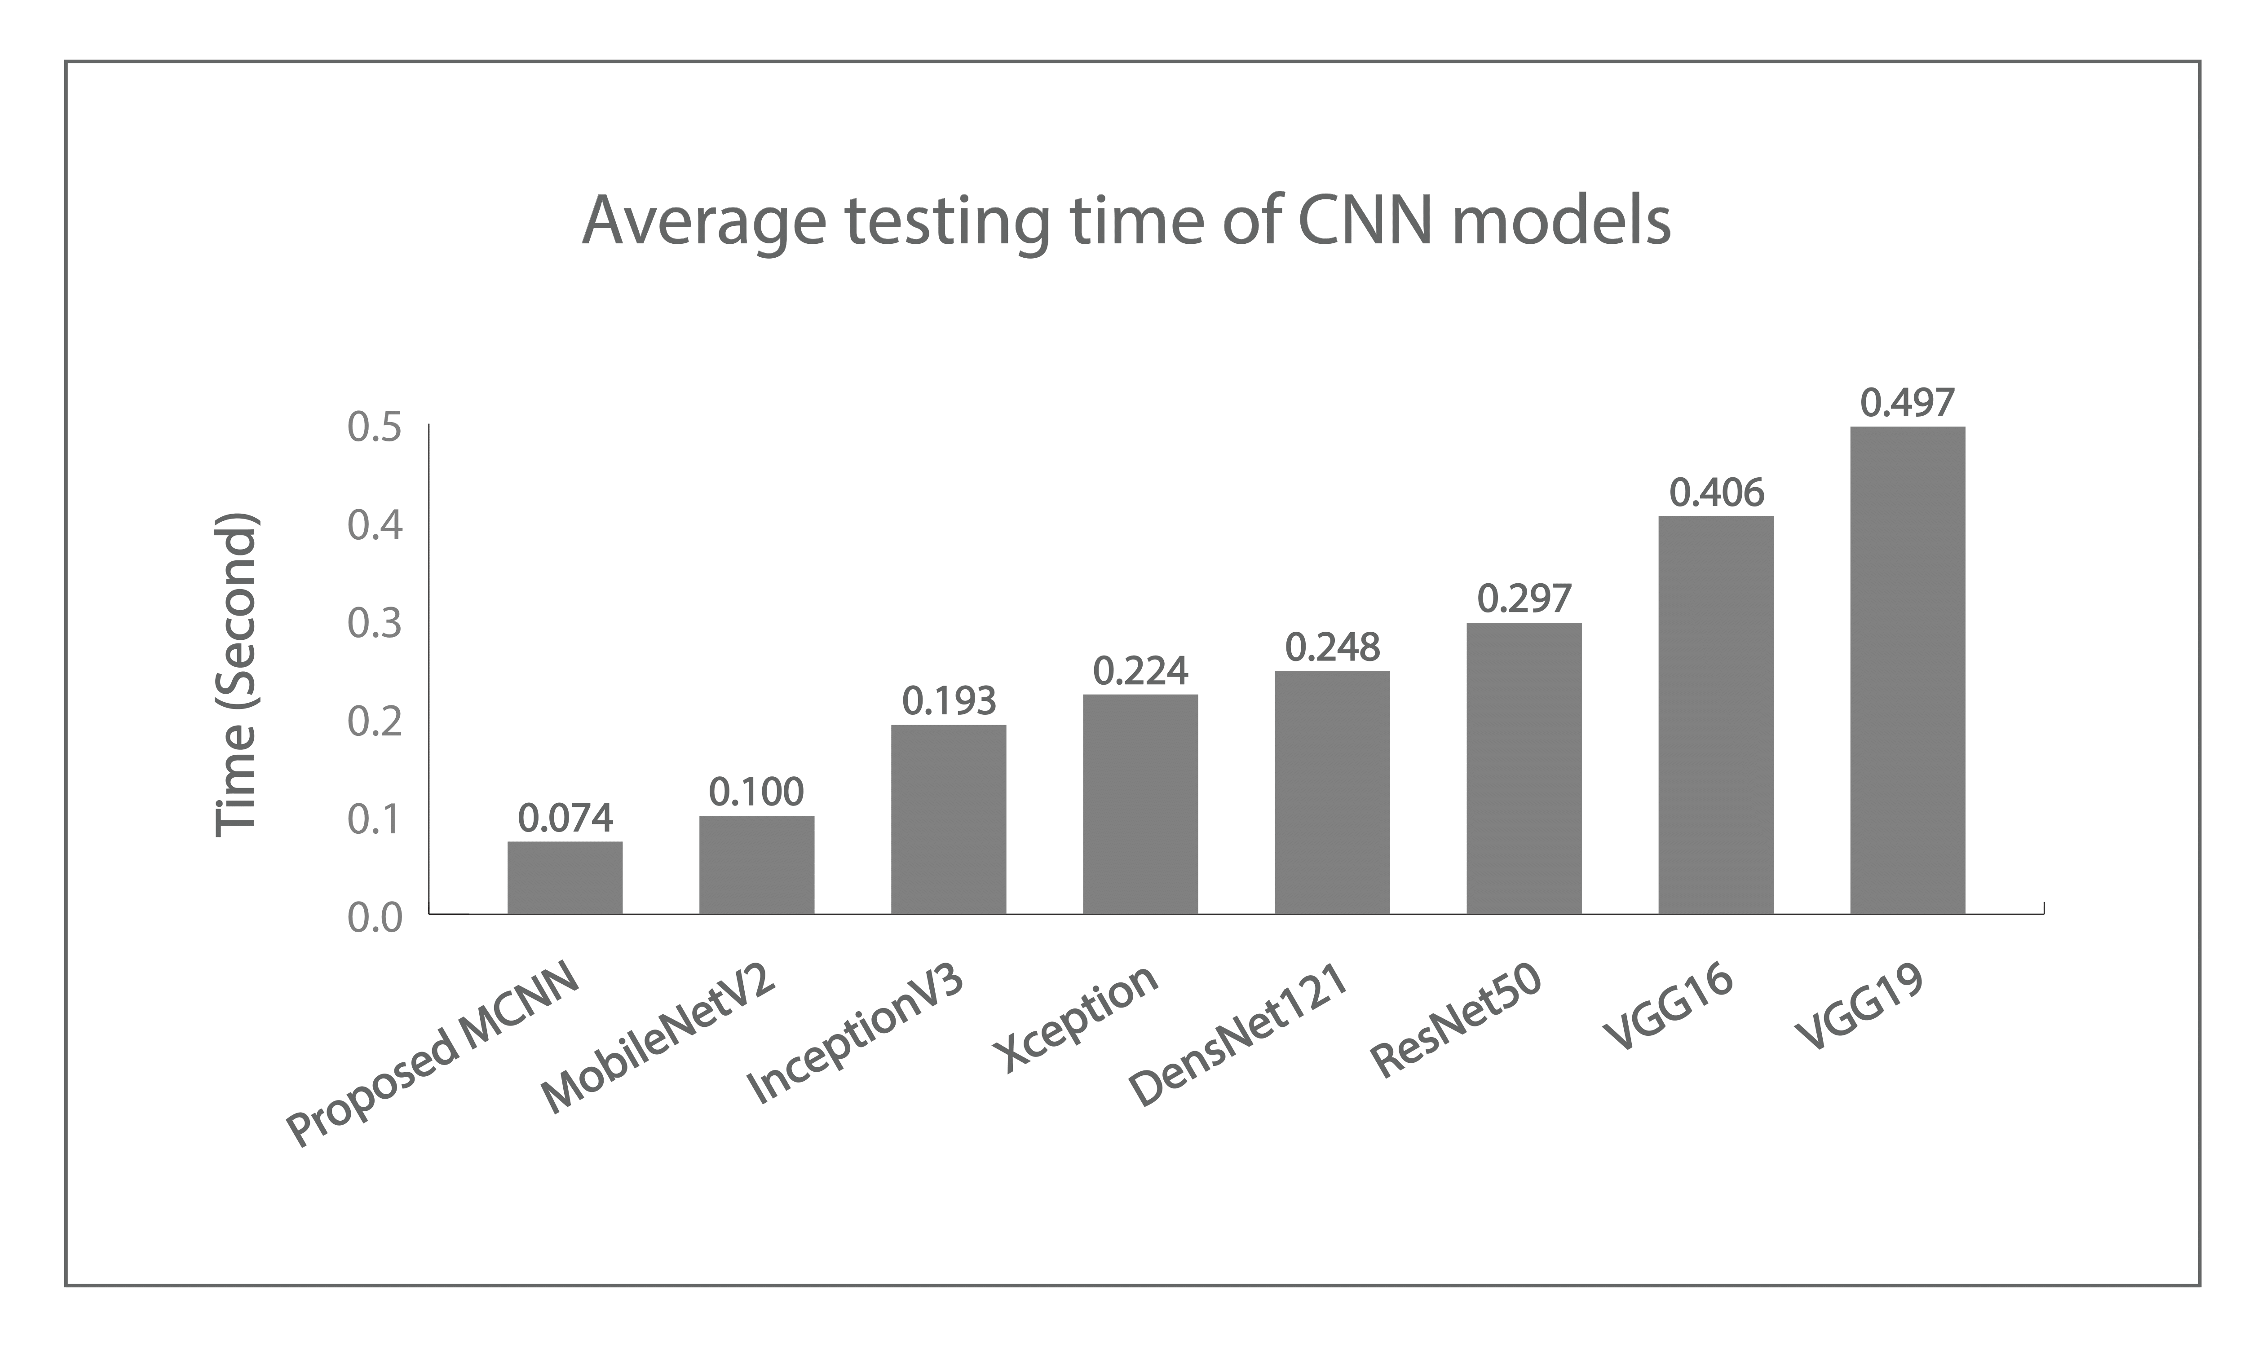
17

Slide 20
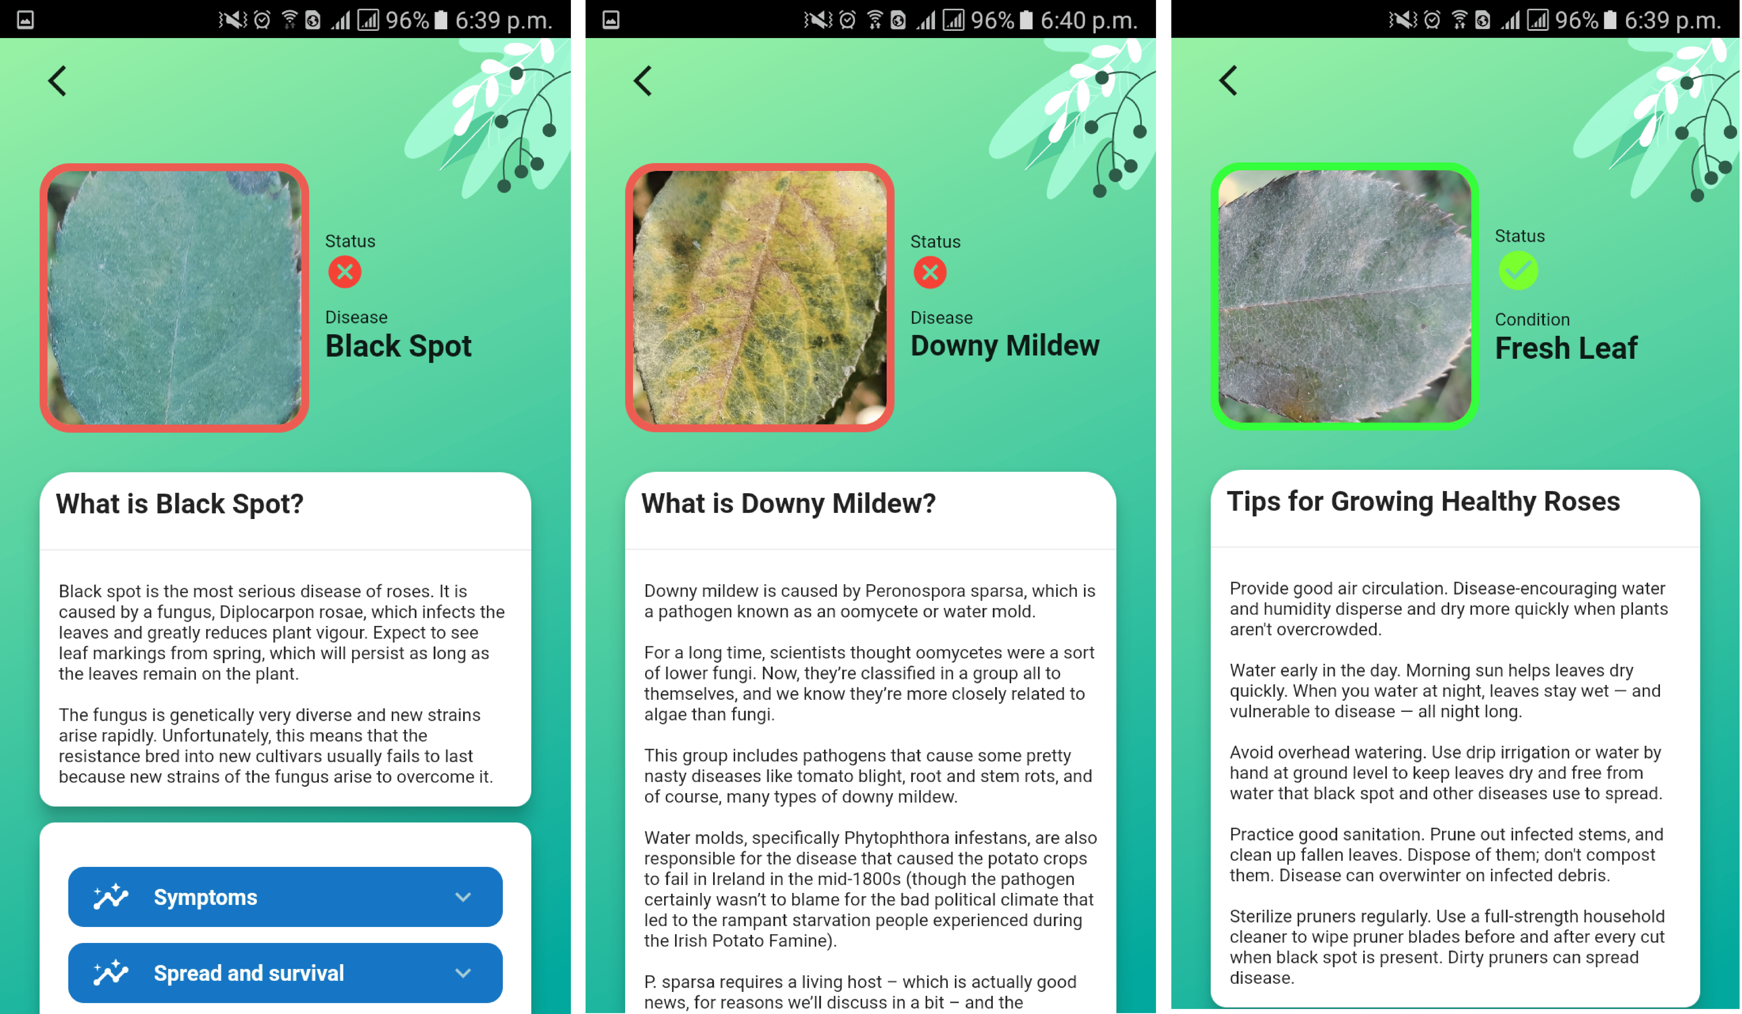
18

Slide 21
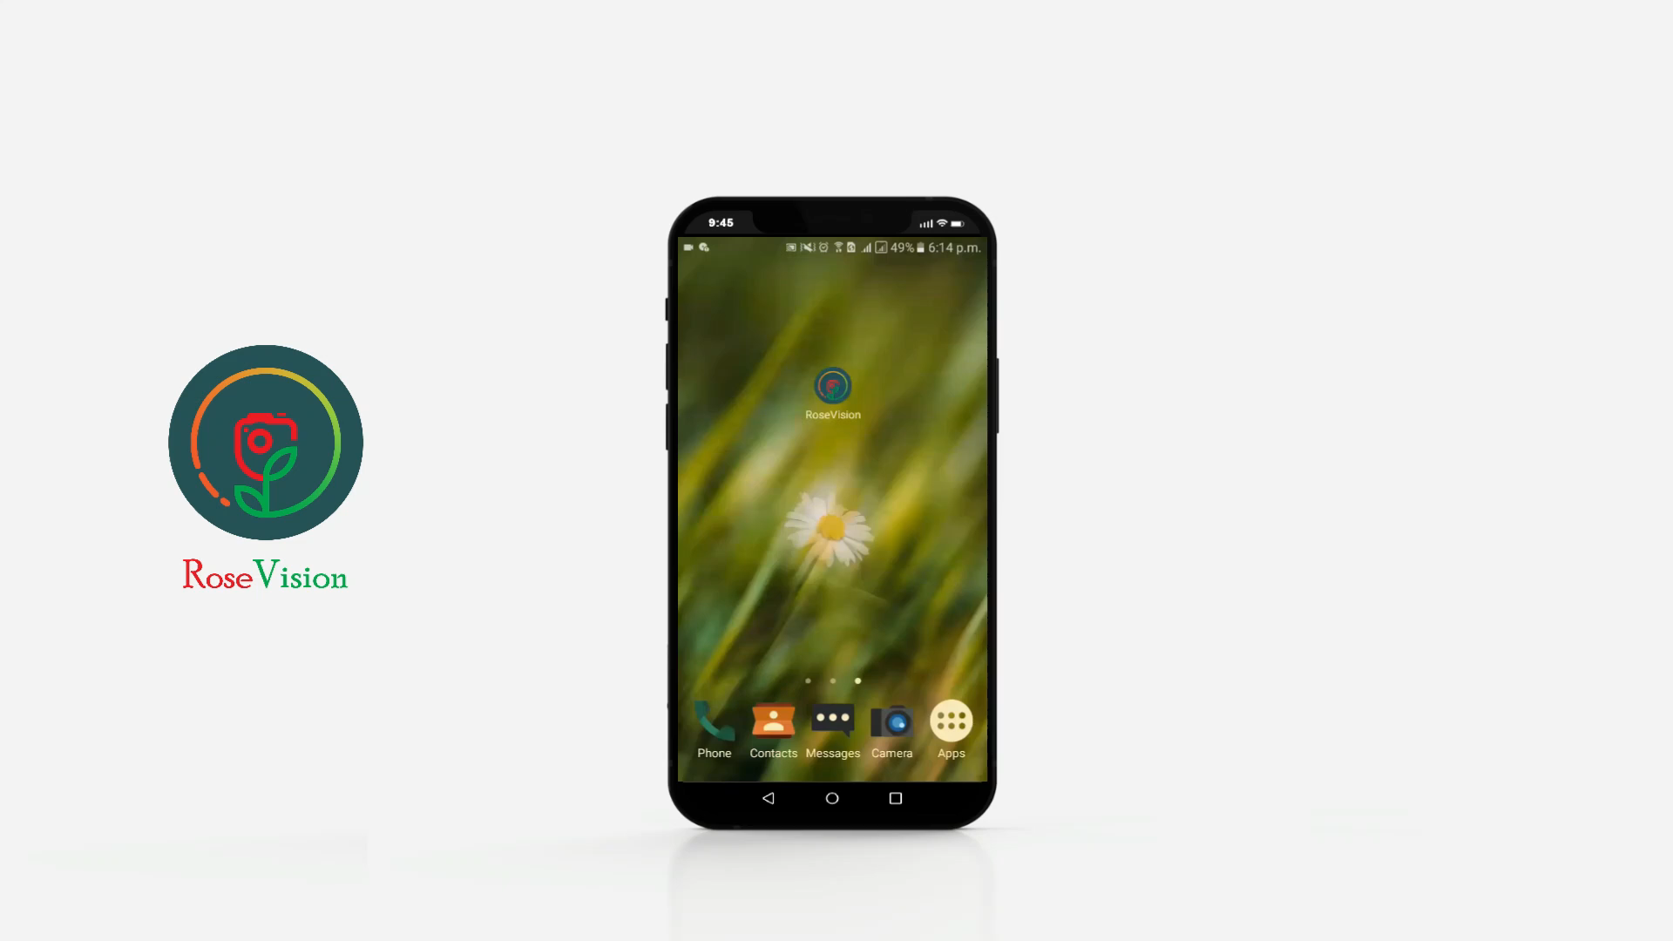

19
Download

Slide 22
20
Conclusion
In this paper, a Modified Convolutional Neural Network (MCNN) is offered to distinguish between healthy leaves and two different rose leaf diseases (Black Spot and Downy Mildew), with a testing accuracy of over 97%, and testing time of 0.074s.
our provided MCNN model surpassed the pretrain CNN architecture, which is a substantial improvement.
Ultimately, through using the trained MCNN model, we developed the ”RoseVision” Android app, allowing farmers to promptly identify the disease and take the appropriate steps to cure it.
The system will be trained in the future for newer leaf disease classification.

Slide 23
References
[1] M. Sudha, “Economics of protected cultivation of cut-rose for international markets: Role of price prediction models in integrating production with marketing,” Agricultural Economics Research Review, vol. 14, no. 1, pp. 1–15, 2001. [2] S. Sazzad, A. Rajbongshi, R. Shakil, B. Akter, and M. S. Kaiser, “Rosenet: Rose leave dataset for the development of an automation system to recognize the diseases of rose,” Data in Brief, vol. 44, p. 108497, 2022. [3] S. H. Khan, M. N. Hossain, S. Mozumder, S. Sharmin, and N. N. Moon, “Rose leaf disease detection using cnn,” in 2021 IEEE International Conference on Robotics, Automation, Artificial-Intelligence and Internetof-Things (RAAICON). IEEE, 2021, pp. 37–41. [4] M. I. Khaleel, P. G. Sai, A. U. R. Kumar, P. Raja, and V. T. Hoang, “Rose plant leaves: Disease detection and pesticide management using cnn,” in 2022 6th International Conference on Trends in Electronics and Informatics (ICOEI). IEEE, 2022, pp. 1067–1072. [5] S. T. Cynthia, K. M. S. Hossain, M. N. Hasan, M. Asaduzzaman, and A. K. Das, “Automated detection of plant diseases using image processing and faster r-cnn algorithm,” in 2019 International Conference on Sustainable Technologies for Industry 4.0 (STI). IEEE, 2019, pp. 1–5. [6] A. Rajbongshi, T. Sarker, M. M. Ahamad, and M. M. Rahman, “Rose diseases recognition using mobilenet,” in 2020 4th International Symposium on Multidisciplinary Studies and Innovative Technologies (ISMSIT). IEEE, 2020, pp. 1–7. [7] A. L. P. De Ocampo and E. P. Dadios, “Mobile platform implementation of lightweight neural network model for plant disease detection and recognition,” in 2018 IEEE 10th International Conference on Humanoid, Nanotechnology, Information Technology, Communication and Control, Environment and Management (HNICEM). IEEE, 2018, pp. 1–4. [8] S. D. Khirade and A. Patil, “Plant disease detection using image processing,” in 2015 International conference on computing communication control and automation. IEEE, 2015, pp. 768–771. [9] D. Al Bashish, M. Braik, and S. Bani-Ahmad, “A framework for detection and classification of plant leaf and stem diseases,” in 2010 international conference on signal and image processing. IEEE, 2010, pp. 113–118. [10] K. Swetharani and G. V. Prasad, “Design and implementation of an efficient rose leaf disease detection and classification using convolutional neural network,” International Journal of Image Mining, vol. 4, no. 1, pp. 98–113, 2021.
[11] R. Gandhi, S. Nimbalkar, N. Yelamanchili, and S. Ponkshe, “Plant disease detection using cnns and gans as an augmentative approach,” in 2018 IEEE International Conference on Innovative Research and Development (ICIRD). IEEE, 2018, pp. 1–5. [12] S. Nuanmeesri, “A hybrid deep learning and optimized machine learning approach for rose leaf disease classification,” Engineering, Technology & Applied Science Research, vol. 11, no. 5, pp. 7678–7683, 2021. [13] P. K. Kosamkar, V. Kulkarni, K. Mantri, S. Rudrawar, S. Salmpuria, and N. Gadekar, “Leaf disease detection and recommendation of pesticides using convolution neural network,” in 2018 fourth international conference on computing communication control and automation (ICCUBEA). IEEE, 2018, pp. 1–4. [14] E. Ayan and H. M. Unver, “Data augmentation importance for classifi- ¨ cation of skin lesions via deep learning,” in 2018 Electric Electronics, Computer Science, Biomedical Engineerings’ Meeting (EBBT). IEEE, 2018, pp. 1–4. [15] A. Krizhevsky, I. Sutskever, and G. E. Hinton, “Imagenet classification with deep convolutional neural networks,” Advances in neural information processing systems, vol. 25, pp. 1097–1105, 2012. [16] K. Simonyan and A. Zisserman, “Very deep convolutional networks for large-scale image recognition,” arXiv preprint arXiv:1409.1556, 2014. [17] K. He, X. Zhang, S. Ren, and J. Sun, “Deep residual learning for image recognition,” in Proceedings of the IEEE conference on computer vision and pattern recognition, 2016, pp. 770–778. [18] C. Szegedy, V. Vanhoucke, S. Ioffe, J. Shlens, and Z. Wojna, “Rethinking the inception architecture for computer vision,” in Proceedings of the IEEE conference on computer vision and pattern recognition, 2016, pp. 2818–2826. [19] M. Sandler, A. Howard, M. Zhu, A. Zhmoginov, and L.-C. Chen, “Mobilenetv2: Inverted residuals and linear bottlenecks,” in Proceedings of the IEEE conference on computer vision and pattern recognition, 2018, pp. 4510-4520. [20] F. Chollet, “Xception: Deep learning with depthwise separable convolutions,” in Proceedings of the IEEE conference on computer vision and pattern recognition, 2017, pp. 1251–1258.
[21] G. Huang, Z. Liu, L. Van Der Maaten, and K. Q. Weinberger, “Densely connected convolutional networks,” in Proceedings of the IEEE conference on computer vision and pattern recognition, 2017, pp. 4700–4708. [22] R. David, J. Duke, A. Jain, V. Janapa Reddi, N. Jeffries, J. Li, N. Kreeger, I. Nappier, M. Natraj, T. Wang et al., “Tensorflow lite micro: Embedded machine learning for tinyml systems,” Proceedings of Machine Learning and Systems, vol. 3, pp. 800–811, 2021. [23] N. Kuzmin, K. Ignatiev, and D. Grafov, “Experience of developing a mobile application using flutter,” in Information Science and Applications. Springer, 2020, pp. 571–575.

Slide 24





0
Why Us
Faster
Lighter
More Accurate
Mobile App

Slide 25
RoseVision
Thank You!
Saidul Islam Nayan Syed Mahfuzur Rahman Nosin Ibna Mahbub

